Slide 1
hard and soft palate
MS.c. Ruqaya K.J

Slide 2
Hard palate
Various regions in the hard palate differ because of the varying structure of the submucousa layer. The following zones can be distinguished
1. Gingival region, adjacent to the teeth
2. Palatine raphe, also known as the median area, extending from
the incisive or palatine papilla posteriorly
3. Anterolateral area or fatty zone between the raphe and gingiva
4. Posterolateral area or glandular zone between the raphe and gingiva.

Slide 3
The bones of the hard palate are covered by a mucosa, which exhibits a series of transverse ridges called rugae. The mucosa is covered by a keratinized stratified squamous epithelium,
The lamina propria that blends with the submucosa without an intervening lamina muscularis, forming a propriasubmucosa.
the propria-submucosa. Branched tubuloacinar mucous and seromucous minor salivary glands (palatine glands)

Slide 4
The lamina propria, a layer of Except for narrow and specific zones, the palate hasn't a distinct submucous layer. palatine tissue is identical with the gingiva and along the midline for the entire length of the hard palate—the palatine raphe.
The submucous space is thus subdivided into irregular intercommunicating compartments of various sizes. These are filled with adipose tissue in the anterior part and with glands in the posterior part of the hard palate. The presence of fat or glands in the submucous layer acting as a cushion.

Slide 5
The distance between lamina propria and periosteum is smaller in the anterior than in the posterior parts. In the anterior zone the connective tissue contains fat .
whereas in the posterior part it contains mucous glands.

Slide 6
The soft palate
The soft palate consists of a core of skeletal muscle fibers with a mucosa covering both surfaces. The oropharyngeal (ventral) surface is covered by a stratified squamous epithelium. The nasopharyngeal (dorsal) surface is covered by a stratified squamous epithelium caudally and a ciliated, pseudostratified columnar epithelium rostrally.
The propria-submucosa contains branched tubuloacinar mucous and seromucous palatine glands. Lymphatic tissue occurs in the mucosa

Slide 8
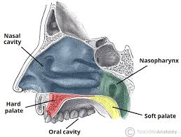

Slide 9
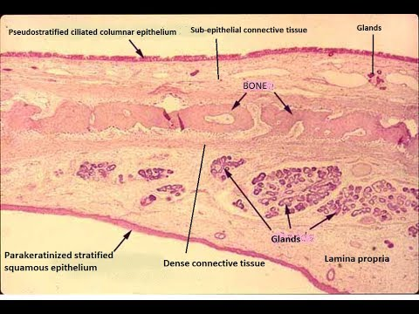

Slide 14
Hard palate anterior
SUB-m.
Fatty t.
m.

Slide 16
bone
gland
periosteum
mucosa

Slide 18
A - palatine glands B - bone of hard palate | C - oral cavity D - oropharyngeal cavity

Slide 20
THANK YOU

